Slide 1
Prokaryotic Cells

Slide 2
In this Smart Lesson, we will be:
1. | Defining the characteristics of prokaryotic cells.
2. | Outlining the relationship we have with bacteria.

Slide 3
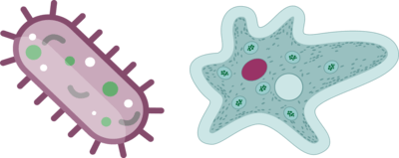
Prokaryotic cells are cells that do not have a nucleus.
They are so small that you cannot see them with your naked eyes, so you might not think these cells are very important or interesting. In fact, they are both! You would not be here if it weren't for prokaryotes.

Slide 4
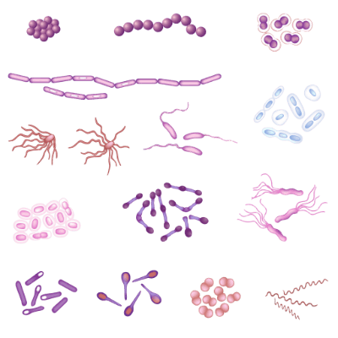
Did you know there are more prokaryotic organisms on Earth than eukaryotic organisms?
It is estimated that there are up to 6×10³⁰ (6 nonillion) prokaryotic cells on Earth. That's a lot!

Slide 5
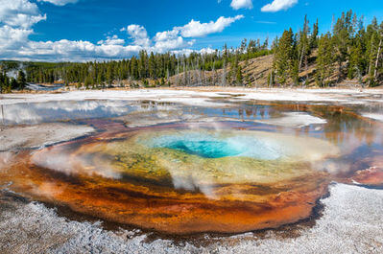
Prokaryotic cells are also the oldest cells in the world.
The first organism on Earth is thought to have been a cell similar to the Archaea we see living in extreme environments today. In fact, "archaea" means "ancient", which is how the kingdom Archaea got its name.

Slide 6
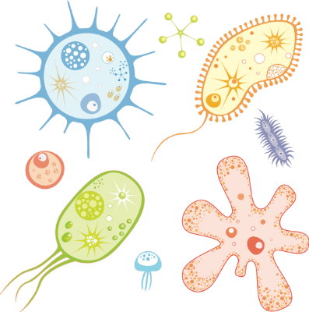
Prokaryotic cells have a more simple structure than eukaryotic cells.
They do not have a nucleus or other organelles surrounded by a membrane.
This is how prokaryotes received their name:
Pro = Before; |  | Karyon = Nucleus

Slide 7
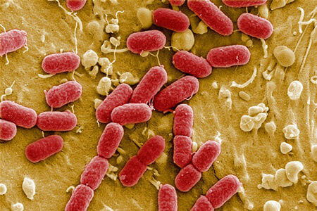
Prokaryotic organisms are always unicellular.
This is because their cell structure is too simple for the cells to become specialised and rely on other cells to carry out important functions, like what occurs in multicellular organisms.

Slide 8

Organisms in the kingdoms Bacteria and Archaea are prokaryotic.
You have probably heard of bacteria before, but what about Archaea? These are single-celled organisms that play essential roles in the environment. They often live in extreme environments, such as in geothermal vents which are very hot and acidic.
Some scientists think that Archaea are the earliest forms of life!

Slide 9
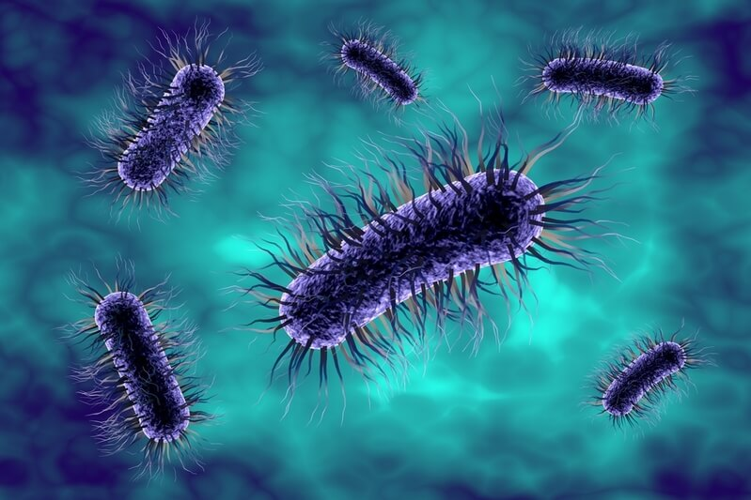
So what is our relationship with bacteria?
When we think of bacteria, we often think of germs and things that can make us sick. However, there can be good bacteria too! Remember, bacteria are prokaryotic cells with no nucleus.

Slide 10

Bacteria can be harmful and cause disease.
These bad bacteria are called "pathogenic" bacteria. An example of a pathogenic bacteria is Salmonella enterica.
Many cases of food poisoning are caused by this bacteria. It is often found in undercooked meat and poultry products.
Luckily, your body has a fantastic defence system that can fight off many types of pathogenic bacteria. Our white blood cells fight off harmful bacteria.

Slide 11

Bacteria aren't all bad!
Some also play a very beneficial role in our lives.
These good bacteria help us every single day from digesting food to helping defend our bodies against harmful invaders.

Slide 12
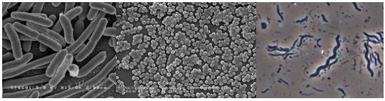
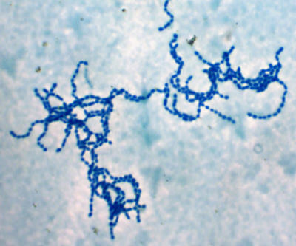
Bacteria come in many different shapes including rods, spheres and spirals.
Sometimes, bacteria cells can even join together to create long chains and other formations.

